Slide 1
Spam Detection

Slide 2
Members
Ammar Khaled Suleiman
Ezz Mohamed Aboelmadarm
Omar Eslam AlSadi
Ali Abed Fayed

Slide 3
What is Spam ?
Spam is any kind of unwanted, unsolicited digital communication that gets sent out in bulk. Often spam is sent via email, but it can also be distributed via text messages, phone calls, or social media.

Slide 4
Purpose of Spam
Advertisements
Pyramid schemes (MLM)
Giveaways
Chain letters
Political email
Stock market advice
One-time notices

Slide 5
Spam As a problem
1-Consumes Computing Resources and Internet resources and time.
2-Reduces the effectiveness of advertising.
3-Fraud.
4-It threatens the very utility of email as a form of communication.
5-It exposes children to inappropriate material.

Slide 6
Spam Filters
Spam filters are designed to identify incoming dangerous emails from attackers or marketers.
Spam filters all have the same basic objective: to keep unwanted emails out of users’ inboxes. However, there are several different types of spam filters, and they each use different filtering methods to hone in on spam.

Slide 7
Types Of Spam Filters
Types Of Spam Filters

Slide 8
1-Content Filters
Content filters analyze the text inside an email and use that information to decide whether or not to mark it as spam. The content of spam emails is often predictable, particularly because they tend to have the same basic objectives: offer deals, promote explicit material, or otherwise tap into human emotions, feelings, and desires, such as greed or fear.

Slide 9
2-Header Filters
Header filters examine the header of an email to see if it may be coming from an illegitimate source

Slide 10
3-Language Filters
Filters based on email body language. Can be Used to filter out spam written in foreign languages.

Slide 11
4-Rule-based Filters
You can use a filter to set up specific rules that can be applied to all emails coming into your system. If the email’s content or origin matches one of the rules, it can be automatically sent to a spam folder. For example, you can set the filter to look for specific words or phrases in the body of an email. If these words are present, the message gets sent to the spam folder.

Slide 12
5-Bayesian Filter
A Bayesian filter can learn your preferences by examining the emails that you send to spam. It observes the content of the emails you mark as spam and then sets up rules accordingly. These rules are then applied to future emails trying to get into your inbox.

Slide 13




Filter Properties
Filter must prevent spam for entering inboxes
able to detect spam without blocking the ham
Do not Require any modification to existing e-mail protocols
Easily Incremental

Slide 14
Bayesian Classification
Particular words have probabilities of occurring in spam email more than others
The filter does not know these probabilities in advance and must be trained
The filter does not know these probabilities in advance and must be trained
to train the filter the user must have a proper dataset

Slide 15
The probabilistic model of naive Bayes
Bayes classifiers can outperform the more powerful alternatives
Being relatively robust, easy to implement, fast, and accurate, naive Bayes
classifiers are used in many different fields

Slide 16
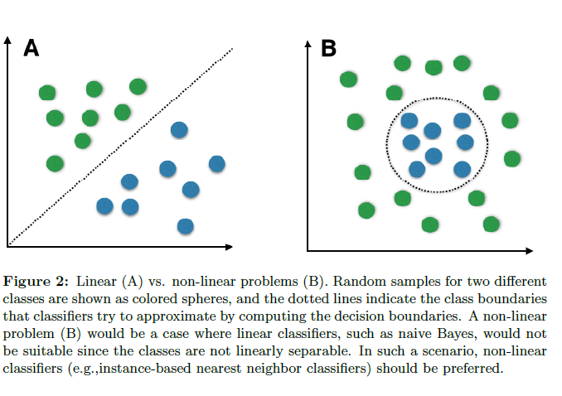
However, strong violations of the independence assumptions and non-linear classification problems can lead to very poor performances of naive Bayes classifiers

Slide 17
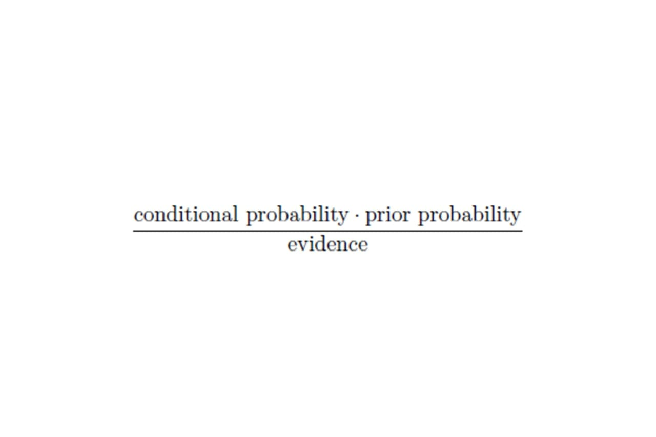
Bayes' theorem forms the core of the whole concept of naive Bayes classification. The posterior probability, in the context of a classification problem, can be interpreted as: "What is the probability that a particular object belongs to class i given its observed feature values?"

Slide 18
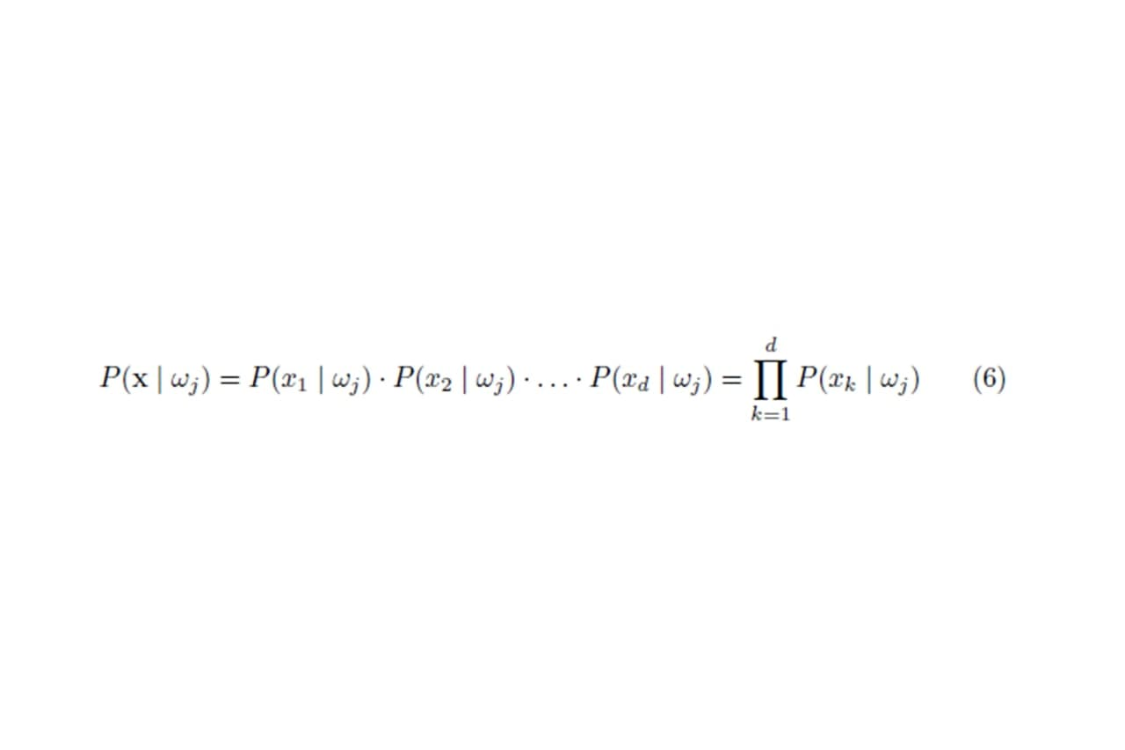
One assumption that Bayes classification make is that the samples are independent and identically distributed.

Slide 19
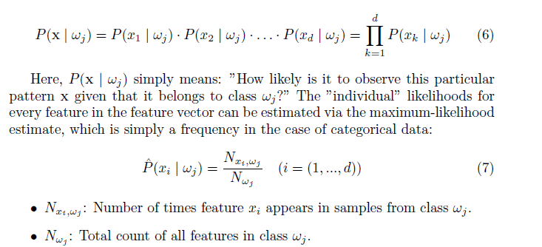

Slide 20
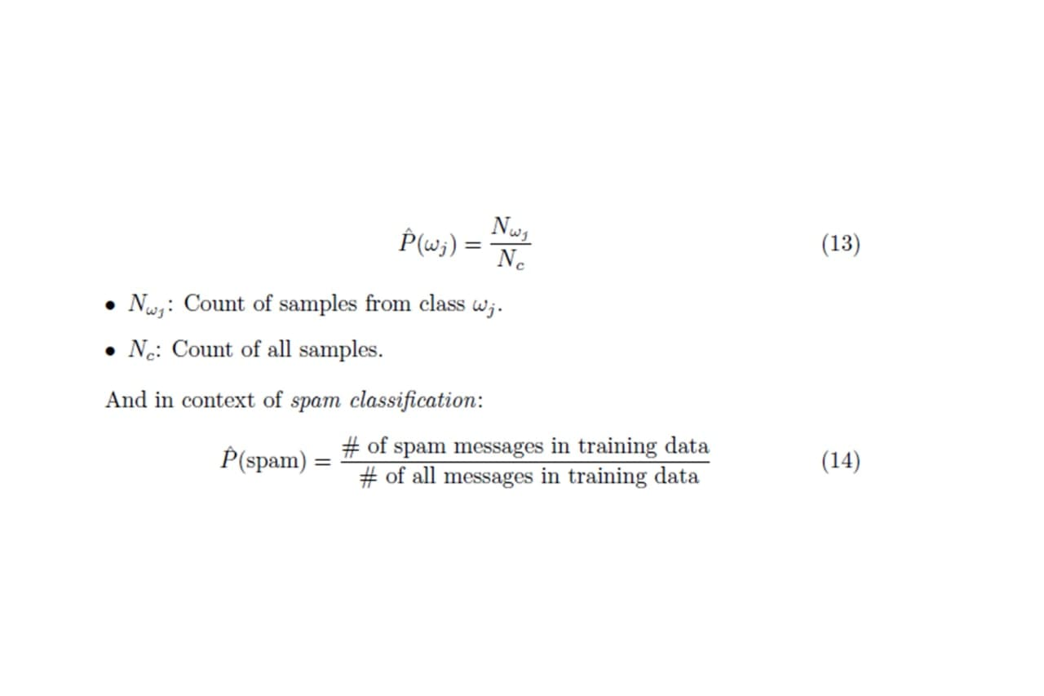
Eventually, the a priori knowledge can be obtained, e.g., by consulting a domain expert or by estimation from the training data (assuming that the training data is i.i.d. and a representative sample of the entire population. The maximum-likelihood estimate approach can be formulated as

Slide 21
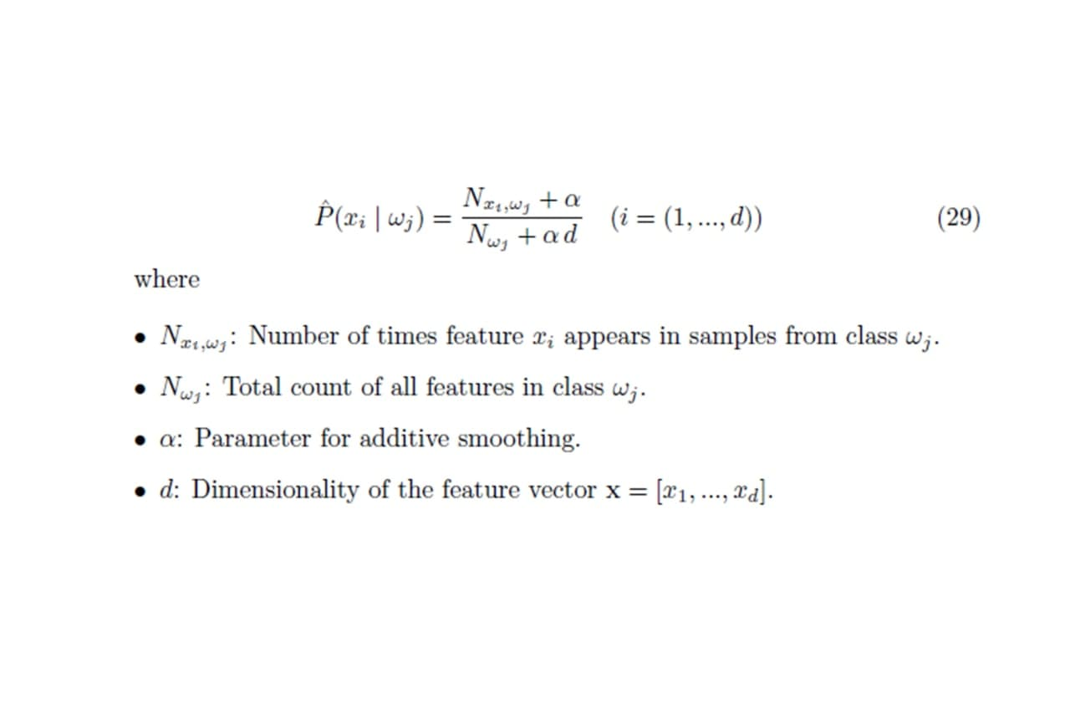
Additive Smoothing The classification was straight-forward given the sample is already present in the dataset. A trickier case is a sample that has a "new" value for is not present in the training dataset. In order to avoid the problem of zero probabilities, an additional smoothing term can be added to the multinomial Bayes model. The most common variants of additive smoothing are the so-called Lidstone smoothing ( < 1) and Laplace smoothing ( = 1).

Slide 22
Pre Processing Steps
Tokenization :
→ describes the general process of breaking down a text corpus into individual elements that serve as input for various natural language processing algorithms
Stop Words
→ Stop words are words that are particularly common in a text corpus and thus considered as rather un-informative
Stemming and Lemmatization
→ Stemming describes the process of transforming a word into its root form
N –grams
→ In the n-gram model, a token can be defined as a sequence of n items

Slide 23
Thank you
Mirjam Nilsson​
mirjam@contoso.com
www.contoso.com

